Slide 1

Restaurant Review Website
Team 1
MENUMATCH
Notes:
Hello everyone, thank you for joining us today. My name is [Your Name], and I’m excited to present our project, MenuMatch. This is a restaurant review platform specifically designed to help users discover restaurants that match their dietary preferences."

Slide 2
Team Members
Team Leader - Dirgha Jivani.
Requirement Leader - Roshni Dodhi.
Design and Implementation Leader - Anshul Raj.
Configuration Leader - Vignesh S.
Security Leader - Prayushi Khandelwal.
QA Leader - Jiho Cheon.
Design and Implementation Leader. - Pratyush Patel

Slide 3
Overview
Project: A platform for users to discover and review restaurants based on specific food types or dietary preferences.
Motivation: Finding appropriate food options for particular diets (vegan, gluten-free, etc) can be challenging for international students studying in Boston.
Goal: Simplify the search for restaurants based on dietary preferences.
Target Audience: People with dietary limitations (locals, tourists, international students, and health-conscious people).
Notes:
"MenuMatch is a platform that allows users to discover restaurants based on specific food types or dietary needs, like vegan or gluten-free options. Our goal is to simplify the search for dining options that cater to dietary restrictions, especially for international students and health-conscious individuals in Boston."

Slide 4
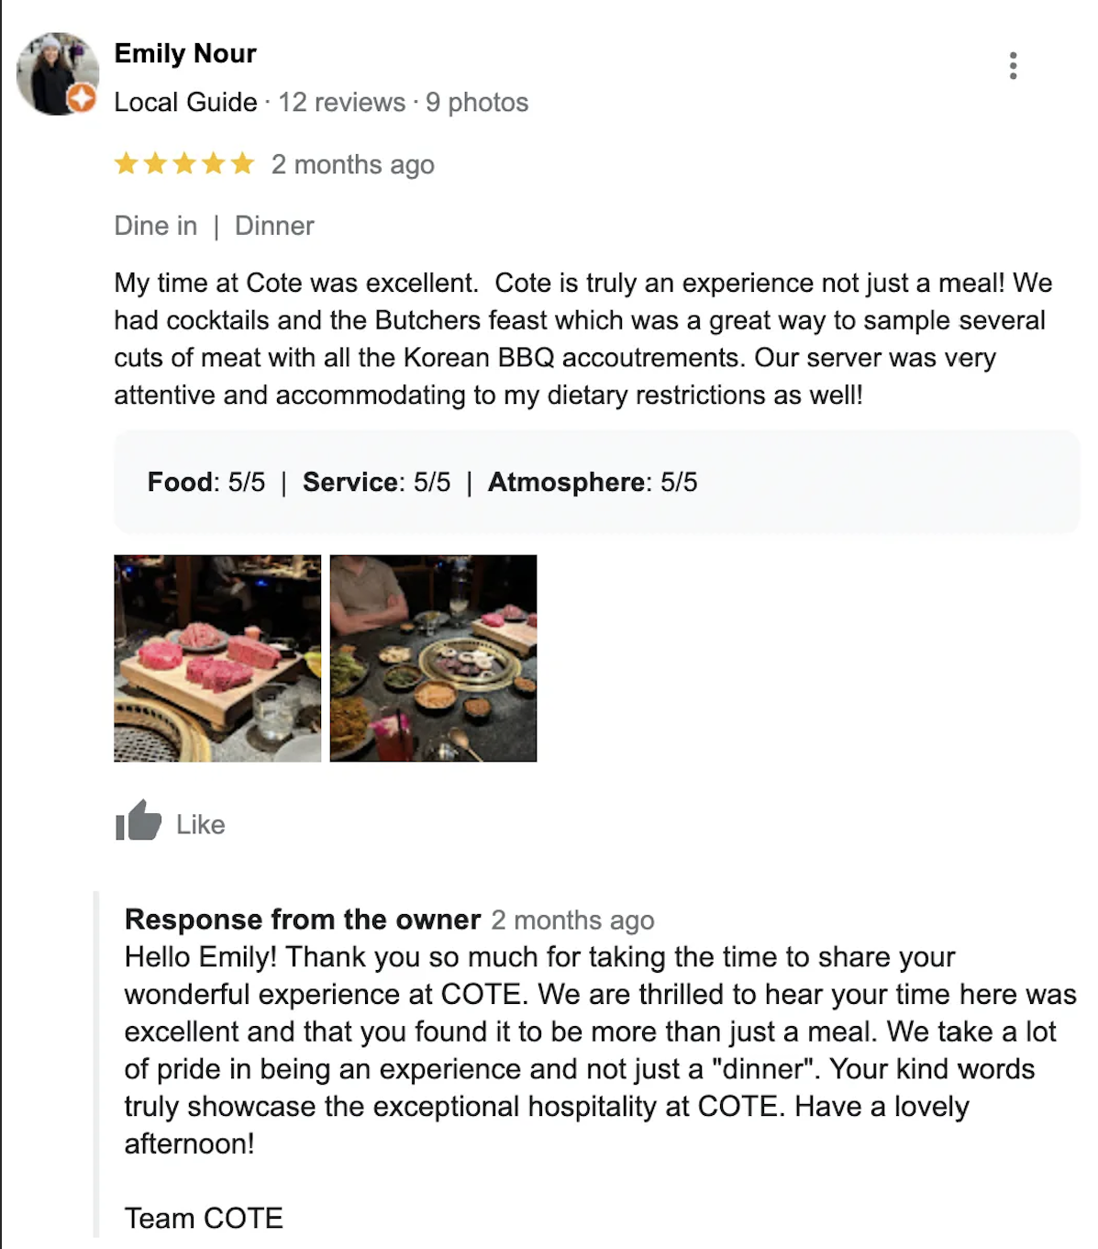
Addressing the Gap in Restaurant Reviews
Current Scenario: Google Maps
Widely Used Platform: One of the most popular tools for finding restaurant reviews.
Limitations:
Provides general insights into restaurant quality.
Lacks detailed information on specific cuisines or dishes.
Does not cater to special dietary needs effectively.
Our Solution: Tailored Food Reviews
Curated Reviews: Focuses on users' dietary preferences and needs.
Detailed Insights: Offers reviews based on specific food categories, including special diets.
Personalized Experience: Allows users to easily find restaurants that align with their dietary requirements, unlike the generic ratings on Google Maps.
Notes:
"Current platforms like Google Maps provide general restaurant reviews but don’t cater to specific dietary needs. MenuMatch offers curated reviews tailored to users’ dietary preferences, allowing for a personalized experience that makes finding the right food easier."

Slide 5
Functional Requirements
Essential Features:
Food Type Selection
Overall Restaurant Review
Curated Reviews Based on User Choices
User-Submitted Reviews for Specific Food Types
Mobile & Web Accessibility
User Registration & Profile Management
Desirable Features:
User Nationality Input
Optional Features:
Food Flavor Descriptions
Food Photo Uploads
Notes:
Food Type Selection
Feature: As a user, I want to choose the type of food or dietary preference (e.g., vegan, halal, gluten-free), so that I can find restaurants offering food that matches my needs.
Estimated Effort: 15-20 person hours
Overall Restaurant Review
Feature: As a user, I want to see the overall rating of a restaurant, so that I can quickly gauge the general quality of the establishment.
Estimated Effort: 10-12 person hours
Curated Reviews Based on User Choices
Feature: As a user, I want to see curated reviews for the specific type of food I selected, so that I can assess how good the restaurant is for my dietary preference.
Estimated Effort: 20-25 person hours
User-Submitted Reviews for Specific Food Types
Feature: As a user, I want to add reviews for a specific type of food at a restaurant, so that others can benefit from my experience.
Estimated Effort: 15-20 person hours
Mobile & Web Accessibility
Feature: As a user, I want to be able to access the platform via both web and mobile devices, providing a responsive and user-friendly interface on each.
Estimated Effort: 15-20 person hours
User Registration & Profile Management
Feature: As a user, I want to be able to sign-up, log in, and manage the profile and update it anytime I want.
Estimated Effort: 15-20 person hours

Slide 6
Nonfunctional Requirements
Security & Privacy
Performance Requirements
Scalability
Availability
Usability
Compliance
Notes:
Security & Privacy
The platform must implement standard security protocols to protect user data, including dietary preferences and location data.
The platform must implement strong security protocols such as HTTPS for all communications to ensure data encryption.
Performance Requirements
The platform should be able to handle up to 10,000 concurrent users without a noticeable decline in performance.
Search and filtering operations should return results within 2-3 seconds under normal load conditions.
The platform should be optimized for fast loading times, with a page load time of less than 3 seconds for most users.
Scalability
The platform must be able to scale horizontally and vertically to accommodate an increasing number of users, restaurants, and reviews as the user base grows.
The system architecture should support adding new features or expanding functionality without significant rework.
Availability
The platform must maintain a minimum uptime of 99.9%, ensuring high availability to users.
In case of system downtime for maintenance, users should be notified in advance.
Usability
The user interface should be intuitive, with a clear and easy-to-navigate design.
Both web and mobile versions should provide a consistent user experience, with a responsive design for varying screen sizes.
Compliance
The platform must adhere to data protection regulations such as GDPR for users based in the European Union, ensuring the proper handling of personal data.

Slide 7
Objectives and Priorities
Complete All Essential Features
Deploy the Software Successfully
Ensure No Known Bugs
Maintain High Quality
Implement Desirable and Optional Features
Notes:
Complete All Essential Features
Focus on implementing core functionalities: food type selection, overall restaurant reviews, curated reviews, and user-submitted reviews for specific food types.
Deploy the Software Successfully
Ensure a smooth and stable deployment across web and mobile platforms, providing users with reliable access.
Ensure No Known Bugs
Prioritize a bug-free experience through thorough testing to maintain platform stability and performance.
Maintain High Quality
Deliver a clean, intuitive interface with fast, reliable performance, ensuring accurate and relevant results.
Implement Desirable and Optional Features
After the core is stable, focus on additional features like nationality input, flavor descriptions, and photo uploads to enhance user experience.

Slide 8
Configuration Management Plan
Version Control and Management
Git/GitHub
Task Management and Tracking
JIRA
Hosting and Deployment
AWS
Jenkins
Containerization
Docker
Code Commit Guideline and Git Branching Strategy
GitHub Flow
Peer Reviews
Automated Testing
Pre-Commit Hooks
CI/CD Plan
Automated Deployment
Scheduled Pipelines
Notes:
Version Control and Management
Git/GitHub: Used for version control and repository management, ensuring collaborative and efficient code management.
Task Management and Tracking
JIRA: Used for task management, time tracking, and organizing development workflows.
Hosting and Deployment
AWS: Application will be hosted on AWS, providing a scalable and reliable environment.
Jenkins: Facilitates automated deployment, testing, and CI/CD pipeline management.
Containerization
Docker: Used for containerization, enabling consistent environments across development and production.
Code Commit Guideline and Git Branching Strategy
GitHub Flow: Main branch remains deployable at all times; features developed in isolated branches.
Peer Reviews: Required before merging to maintain code quality; repository owners manage the main branch access.
Automated Testing: CI/CD pipeline includes a test stage; feature branches must pass tests before merging.
Pre-Commit Hooks: Enforces code quality checks before committing code to prevent issues during deployment.
CI/CD Plan
Automated Deployment: Jenkins automates code testing and deployment on AWS EC2 instances.
Scheduled Pipelines: CI/CD pipeline runs on the main branch at scheduled intervals (e.g., weekly) to ensure stability.

Slide 9
Risk Management
Team Management and Task Allotment
Feasibility of the Requirements
End to End Testing
Communication

Slide 10
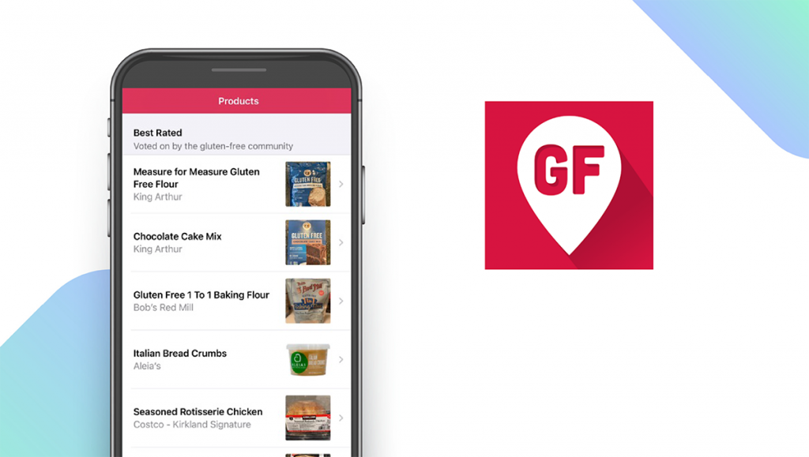
Related Works
Platform like FindMeGlutenFree, focuses on specific dietary needs, such as gluten-free and vegan/vegetarian options, respectively. While useful for niche diets, they fail to cater to a broader range of preferences like keto, halal, or pescatarian, limiting their appeal. Our platform aims to bridge this gap by covering a wider variety of dietary requirements.
General review platforms such as Google Maps and Yelp offer restaurant reviews but lack dedicated filtering options for specific dietary restrictions. Users often need to manually search through reviews to find relevant dietary information. Research, such as the paper "Improving Restaurant Search Results with Dietary Considerations" by Rezzadori and Tsekouras, highlights the importance of including dietary filters in recommendation systems to improve the user experience. which our platform will provide to create a more tailored and inclusive experience.

Slide 11
Conclusion
Existing restaurant review platforms, such as Google Maps and Yelp, offer general insights but fall short in catering to users with specific dietary preferences. Niche platforms like FindMeGlutenFree and HappyCow address certain diets but lack the flexibility to serve a wider range of dietary restrictions such as keto, halal, or sugar-free.
Our project aims to fill this gap by providing a comprehensive solution that tailors reviews and recommendations based on individual dietary needs. By offering curated insights for a variety of diets, we will create a more inclusive and personalized experience for users, helping them find restaurants that align with their health or lifestyle preferences with ease.
This solution will benefit international students, locals, and tourists in Boston by simplifying the search for restaurants that cater to their specific dietary needs. It offers a targeted and user-friendly alternative to existing platforms, providing personalized recommendations for a more convenient dining experience. This focus on dietary preferences fills a key gap in the current restaurant review landscape.

Slide 12
THANK YOU!

